Slide 1
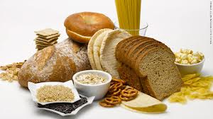
Whole Grains

Slide 2
List Your Grains
Make a list of the grain products you ate yesterday.
Circle the whole grain foods
How many did you have?

Slide 3
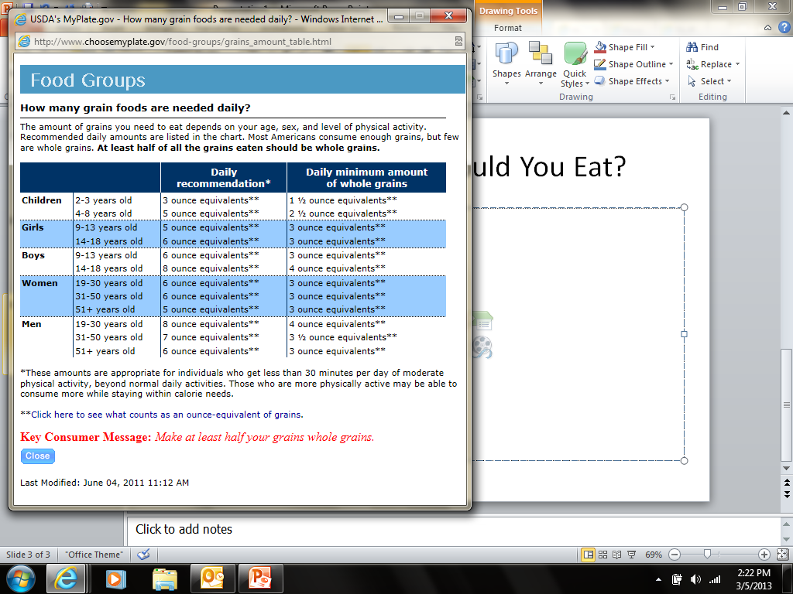
How Much Should You Eat?

Slide 4
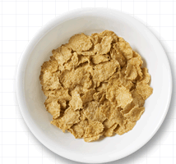
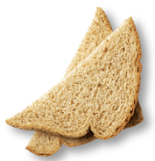
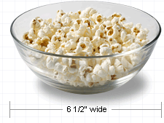
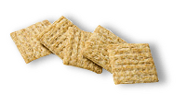
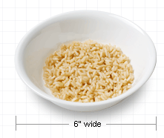
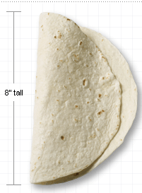
What Counts as an Ounce?
3 cups popcorn
1slice bread
1 cup cereal
5 crackers
½ cup rice or pasta
8” tortilla

Slide 5
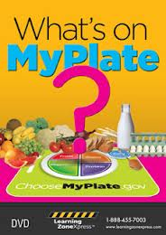
What’s on MyPlate: Grains
http://youtu.be/VLFeALaM5So 2:54

Slide 6
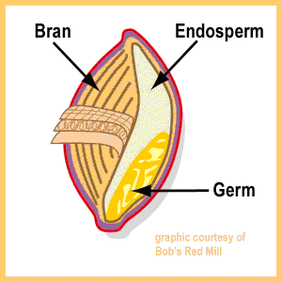
Whole Grain Benefits
Whole grain benefits
Parts of a grain
Have more nutrients
More flavor
Help you feel full longer
Provide fiber

Slide 7

What is fiber?
Benefits of eating fiber
Improves digestion
Keeps you “regular”
Lowers cholesterol
Reduces risk of heart disease and diabetes

Slide 8

How can you tell if it’s whole grain?
“100% whole grain” in the product name
A whole grain as the first ingredient
At least 3g fiber per serving
The Whole Grain Council seal
Two or more of the above clues on one package

Slide 9
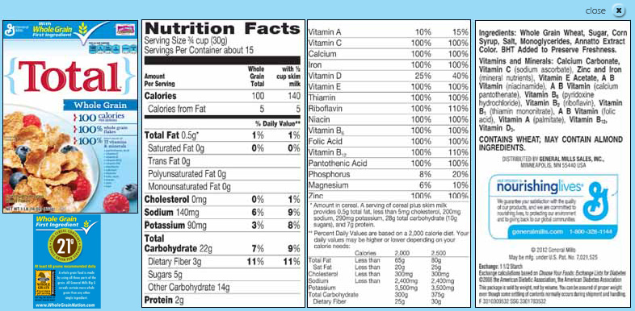
Reading Labels

